Slide 1
Data Structures & Algorithms (CSE 225)

Slide 2
Pre-requisites
Before taking this course you must have successfully passed
CSE 115/115L (Structured Programming)
CSE 215/215L (Object Oriented Programming)
I will imagine that you have a very good knowledge of programming in C.
I will also consider that you have the fundamental concepts of Object Oriented Programming such as
Encapsulation
Classes & Objects
Inheritance
Polymorphism etc…

Slide 3
Reality Check
Have you ever used
Pointers
Arrays
Functions
Structures
Recursion
Dynamic Memory Allocation

Slide 4
Introduction to Data Structures
One of the most fundamental courses in Computer Science
Good knowledge of Data Structures is a must to design and develop efficient software system
We deal with data all the time and how we store, organize and group our data together matters
Let’s pick up some examples from our day-to-day life

Slide 5

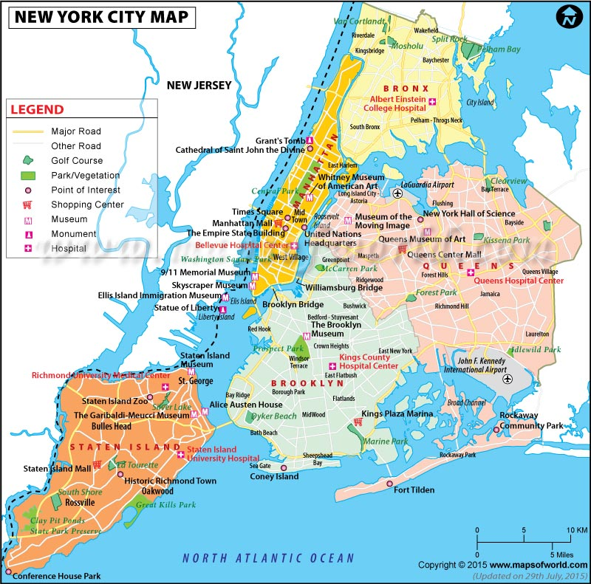
Examples

Slide 6
So, What is a data structure?
A data structure is a way to store and organize data in a computer so that it can be used efficiently.
What do you think efficiency means here?
Can you think of ways data structures can help in real world problem?

Slide 7
How do we study data structures?
When we study data structures, we study them in two ways:
Mathematical / logical models (we look at an abstract view of them or Abstract Data Type)
Implementations of the ADT

Slide 8
List (ADT)
List (ADT)
Store a given number of elements of any data type
Read elements by position
Modify element at any position
Arrays (Concrete Implementation)
Linked List (Concrete Implementation)
Abstract Data types are entities that are definition of data and operations but do not have implementations

Slide 9
What will we learn in this course?
In this course, we will be talking about lots of data structures.
We will be talking them as ADT
We also see how to implement them
Some of the data structures we will study include:
Arrays
Linked List
Stack
Queue
Hash
Tree
Graph …

Slide 10
What will we learn in this course?
We will study
Logical view
Operations
Cost of operations
Implementations

